Slide 1

Presentation on E-commerce Concession Abuse Monitoring and Prevention
Project by: Deepak Maithil
Project Overview: Helping e-commerce platforms prevent improper concession use and maintain business integrity.
Technologies Used: Power BI

Slide 2
AGENDA
Introduction
Objective
Data Gathering
Insight
Insight
Conclusion

Slide 3
INTRODUCTION
E-commerce platforms face increasing challenges related to fraudulent customer refund claims. This project focuses on analyzing and detecting such Concession Abuse Patterns using Power BI.
The Analysis Covers:
Different claim issue types like Empty Box received, Part Missing, Wrong Item received, Material Different Received (MDR), DNR – (Delivered not received), etc.
Customer behavior and repeated refund attempts.
Investigation outcomes and their financial impact.
Forecasting future claim volumes to support proactive planning.
Goal: Empower the business to make data-driven decisions and prevent unnecessary losses due to refund fraud.

Slide 4
Objective
The Primary Objective of this Dashboard is to:
Identify Patterns of Abuse in refund claims.
Quantify and highlight the Concession Saved by denying false claims.
Evaluate the Effectiveness of investigation teams (LMI, ARI, SDFC, SLP).
Track and compare Approved vs Denied claims by issue type.
Forecast Monthly Claim Trends to improve planning and resource allocation.
This initiative supports improved operational efficiency, reduced loss, and stronger fraud detection protocols.

Slide 5
Data Gathering
The Primary steps taken to prepare the dataset for this dashboard included:
Imported raw data from a structured Excel file with 9 key sheets (Customers, Orders, Claims, Investigations, Final Resolution, etc.)
Removed null values and duplicates to ensure consistency and accuracy.
Standardized Date formats, Text cases, and Numeric fields across all tables.
Created calculated columns such as:
Fraud Score
Is High Risk Customer
Repeat Customer
Claim Month Year
Built DAX Measures for:
Total Claims, Approved Claims, Concession Saved, Total Refund Claimed, etc.
Established relationships across tables using Claim ID, Order ID, and Customer ID for proper model linking.
This cleaning and modeling process ensured that the insights derived are reliable and reflect actual business behavior.

Slide 6
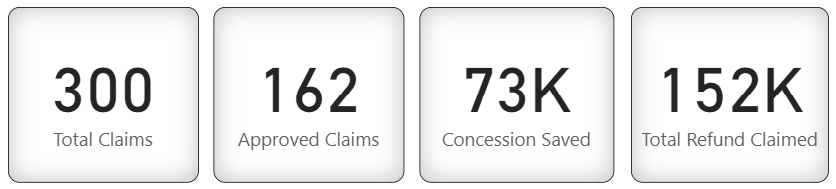
Insights: KPI Summary (Top Cards)
Key Performance Indicators (KPI Overview)
The top of the dashboard highlights core performance metrics related to claims and refunds:
Total Claims: 300 – Total customer claims logged in the system.
Approved Claims: 162 – Claims validated and refunded.
Concession Saved: ₹73K – Total refund amount saved by denying invalid claims.
Total Refund Claimed: ₹152K – Combined value of all refund requests (approved or denied).
Insight:
A high denial volume (138 out of 300) reflects strong fraud control processes, contributing directly to ₹73K saved.

Slide 7
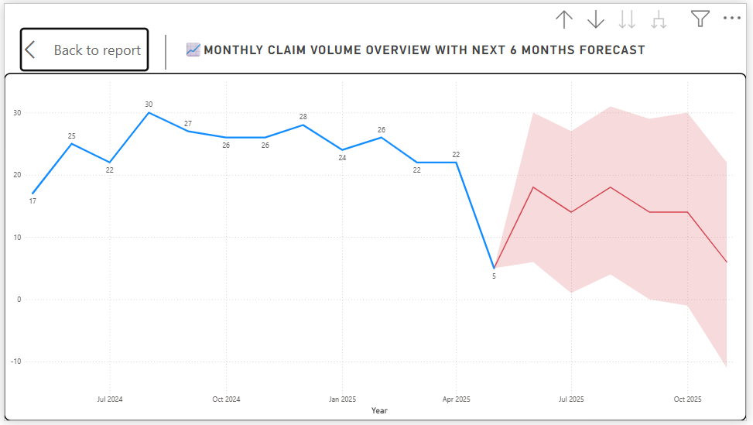
Insight : Monthly Claim Volume with Forecast
Monthly Claim Forecast (Line Chart)
Content:
Displays historical claim data from July 2024 to April 2025.
Uses forecasting to project claims for the next 6 months (up to July 2025).
Insight:
Claims peaked in Q4 2024, but the forecast suggests a slight dip.
Helps proactively plan team capacity and fraud screening in advance.

Slide 8
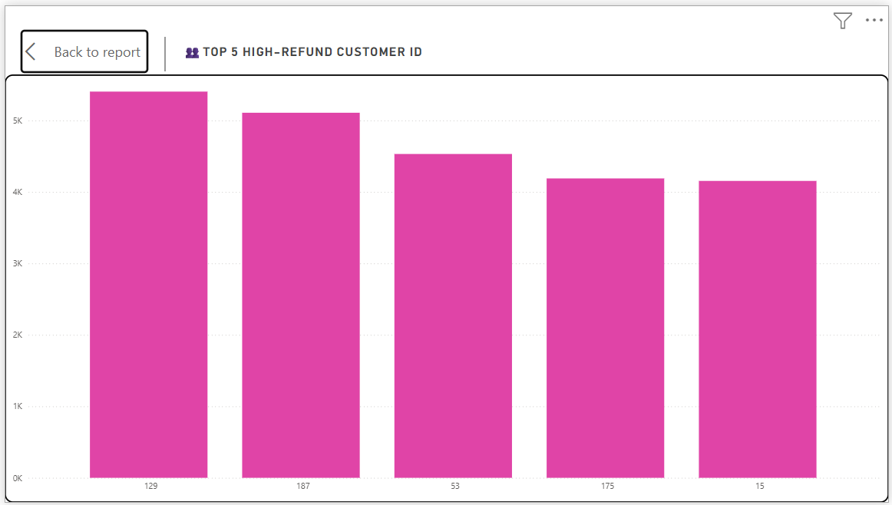
Insight : High-Refund Customers
Top 5 High-Refund Customers:
Content:
Top 5 customer IDs with the highest refund amounts: 129, 187, 53, 175, and 15.
Each customer requested nearly ₹5K–₹6K in refunds.
Insight:
Frequent high-value claims may indicate potential abuse.
Accounts should be monitored or flagged for investigation history.

Slide 9
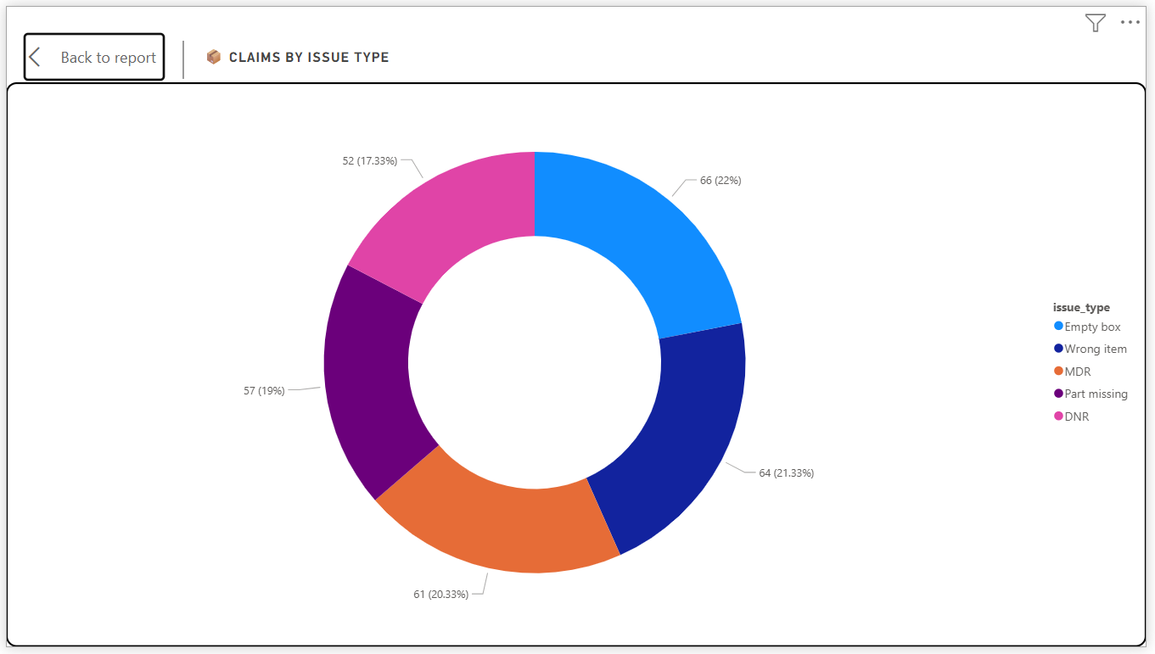
Insight : Claim Distribution by Issue Type
Claims by Issue Type (Donut Chart):
Content:
Empty Box: 22%
Material Different Received (MDR) : 21.33%
Wrong Item: 19%
DNR, Part Missing, etc. make up the rest.
Insight:
Empty box and MDR are the most exploited claim reasons.
These categories may require stricter fulfillment verification.

Slide 10
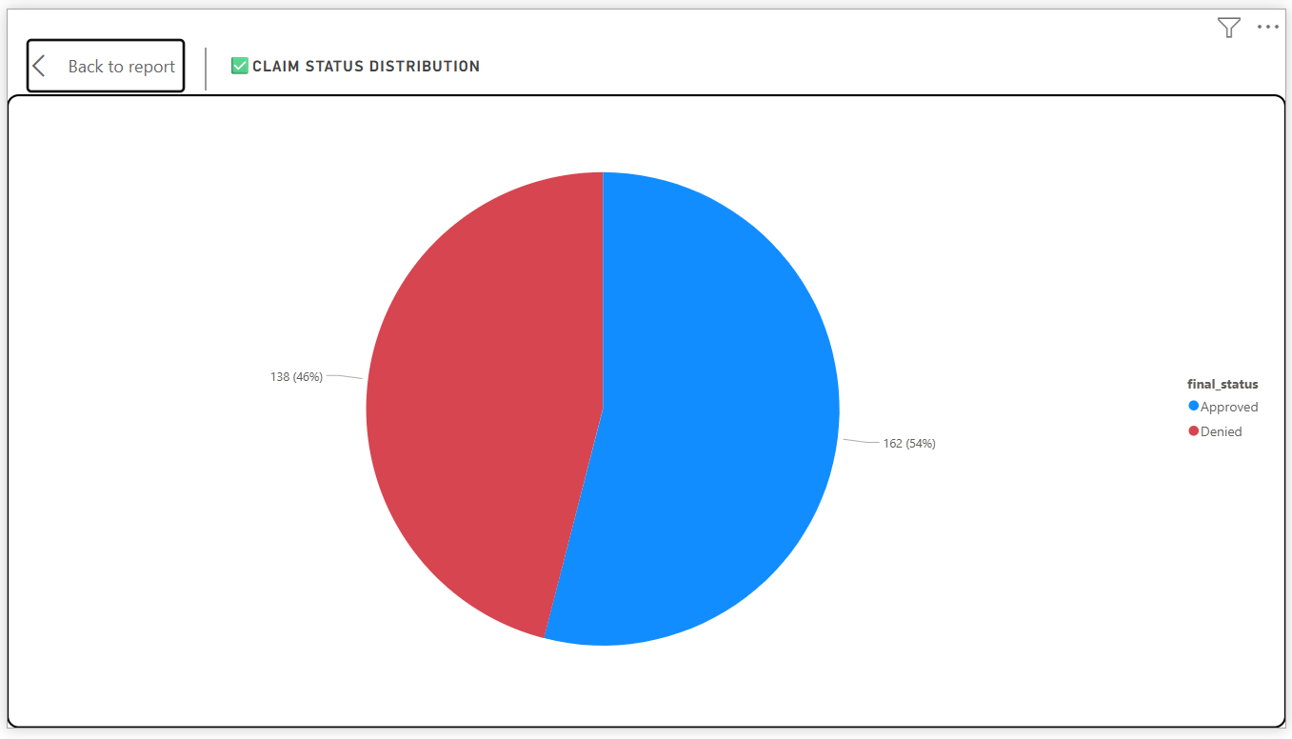
Insight : Final Claim Status
Claim Status Distribution (Pie Chart):
Content:
Approved: 162 (54%)
Denied: 138 (46%)
Insight:
The balance indicates effective review and denial of invalid claims.
A higher denial rate can be interpreted as better fraud prevention.

Slide 11
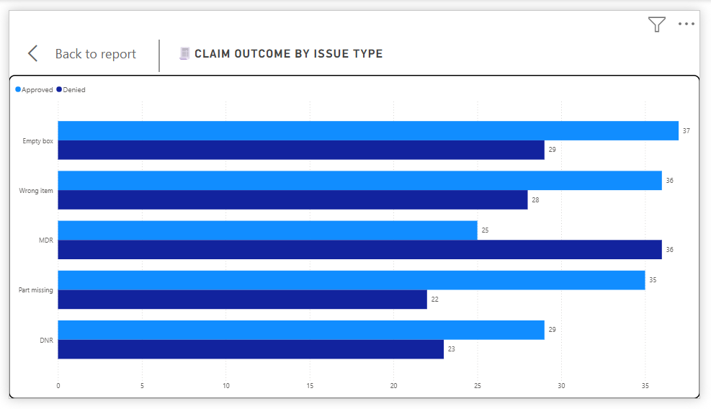
Insight : Approval Rate by Issue Type
Claim Outcome by Issue Type (Bar Chart):
Content:
Breakdown of claims (Approved vs Denied) across each issue:
Empty Box & Wrong Item → Higher Approvals
DNR & MDR → More likely Denied
Insight:
Use this pattern to refine fraud detection rules by issue type.
Some claims may need stronger supporting evidence before approval.

Slide 12
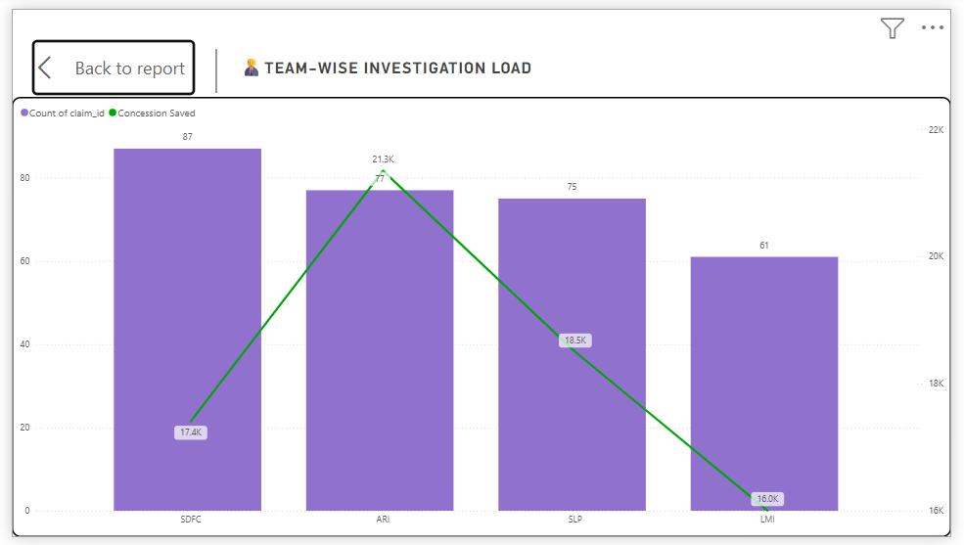
Insight : Investigation Team Performance
Team-wise Investigation Load (Column + Line Chart):
Content:
Claim count by team:
SDFC (87),
ARI (77),
SLP (75),
LMI (61)
Concession Saved:
ARI leads with ₹22K+ saved
Insight:
ARI handles fewer cases than SDFC but saves more money.
Consider realigning teams based on efficiency and value recovered.

Slide 13
Conclusion & Recommendations
Conclusion & Strategic Recommendations
🧠 Conclusion Highlights:
🧾 300 customer claims analyzed to uncover refund abuse patterns.
💰 ₹73K in concessions successfully saved by denying invalid claims.
📦 Most exploited claim reasons: Empty Box and Material Different Received (MDR).
👥 Top 5 customers flagged for frequent high-value claims.
🧑‍💼 ARI team delivered highest cost-saving impact among investigators.
📉 Forecast shows a downward trend in future claims, enabling proactive resource planning.
📌 Strategic Recommendations:
Enhance Security on MDR and DNR issue types by requiring stronger evidence.
Implement a Risk Scoring System to automatically flag repeat refund seekers.
Leverage ARI’s investigative approach across other teams for higher efficiency.
Regularly update and monitor forecasting models to stay ahead of volume spikes.
Integrate real-time alerts in Power BI for high-value or risky claims.

Slide 14
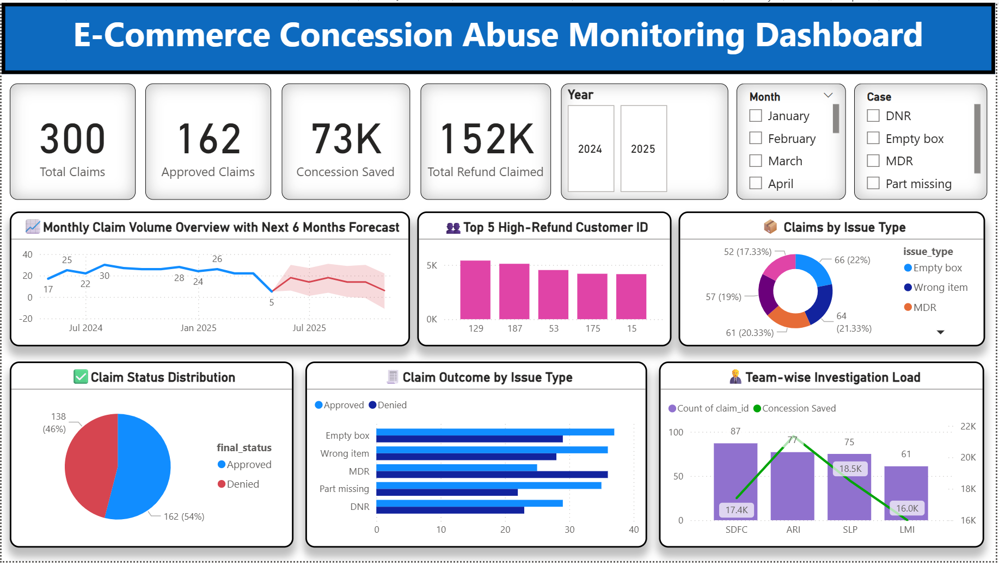
Final Dashboard Overview

Slide 15
Thank You!
Thank you for your time and attention.
This project highlights the power of data in identifying fraud, saving concessions, and improving team efficiency.
Contact for Further Information:
Email: deepakmaithil5778@gmail.com | Contact Number: 7000558393
Tools Used: Power BI
Feel free to connect for any feedback, questions, or collaborations.

